Slide 1
Git, GitHub, and all the Giddy things
Let’s Git into it
https://github.com/mqRusers/2020-10-22-Git-GitHub
- Belinda Fabian & Shubham Chhajed

Slide 2
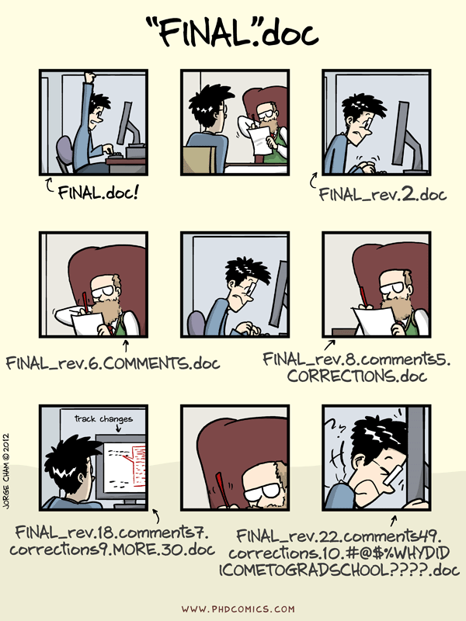
Notes:
You are working with a team on some code or you would like to share your code with someone, or you would like to keep track of what changes you have made to our code

Slide 3
Why version control?
A version control system, or VCS, tracks the history of changes as people and teams collaborate on projects together.
VCS allows teams to recover old versions at any time while running tests, fixing bugs, and adding new code
Which changes were made?
Who made the changes?
When were the changes made?
Why were changes needed?
Notes:
Version control is a category of software that keep track of changes to your files for you. It allows you to:
-keep the entire history of a file and inspect a file throughout its life time
-tag particular version so you can go back to them easily
-facilitates collaborations and makes contributions transparent
-experiment with code and feature without breaking the main project

Slide 4

Git is a distributed version control system
Allows storing entire history of your project on your computer
Developers can work anywhere and collaborate asynchronously from any time zone
Install Git: https://git-scm.com/downloads
Notes:
Avoid redundant tasks, slower timelines, and multiple copies of a single project
Git gives each contributor a unified and consistent view of a project, surfacing work that’s already in progress

Slide 5
Why git?
You can see the entire timeline of the changes, decisions, and progression of any project in one place
Collaborators can safely propose changes to the code
Communication between collaborators is streamlined

Slide 6


Github
It is a commercial website that lets you store your repository publicly for free
Repository is the storage of your project and its history
Advantages:
It offers a friendly interface to many common operations so that you don’t have to remember how to do them at the command line
It provides other useful features including an “Issue tracker” and wikis
Notes:
you can also get an educative account with an .edu email address that will give you some free private accounts
There are other website that offer similar services including BitBucket

Slide 7
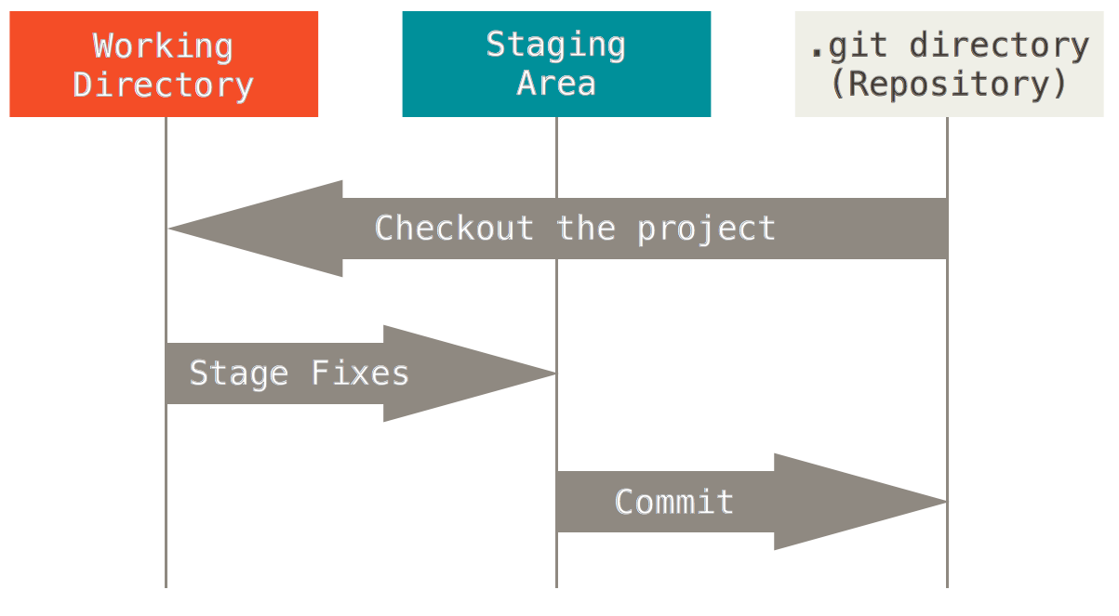

Slide 8
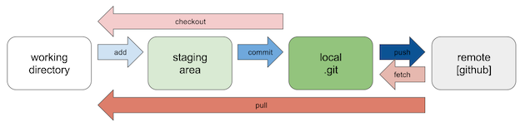

Slide 9
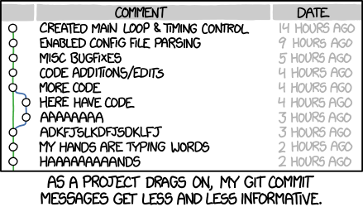
Commits
Don’t do this:
Commits are cheap
Commit often and provide useful messages
This helps keep track of what you are doing
xkcd.com

Slide 10
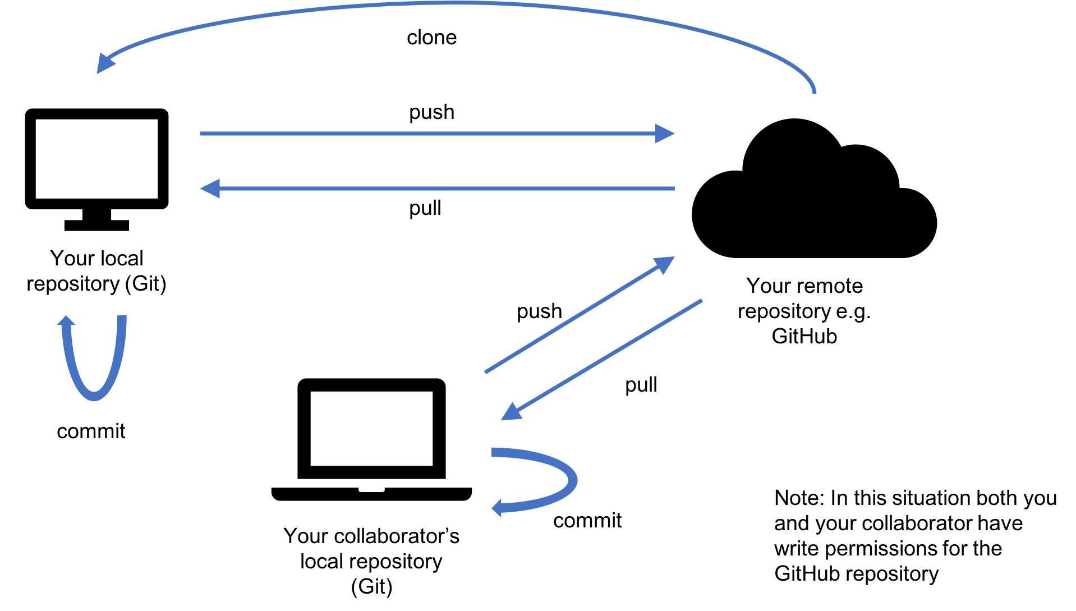

Slide 11
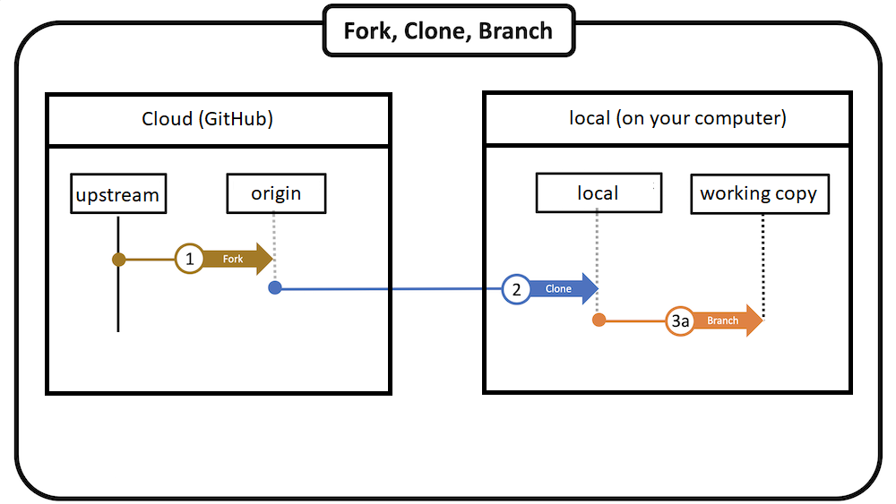

Slide 12

Forking
Producing a personal copy of someone else’s project
A fork acts as a sort of bridge between the original repository and your personal copy
CLone
The fork exists in your GitHub repository
To be able to work on the project, you need to bring it to your computer, i.e., CLONE it

Slide 13
Branching
duplicate your existing repository
→ develop or experiment with a new feature independently
→ you can merge these modifications back into your project
Branching is used when you are contributing to external projects
(projects you are not directly involved with)
Branches can be created in Rstudio OR
in GitHub and then pull the changes in your repository

Slide 14
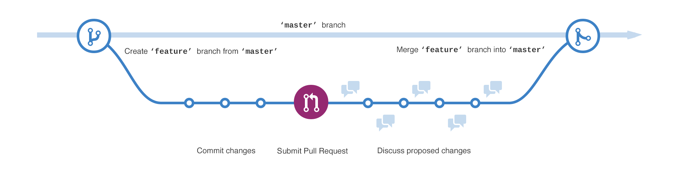

Slide 15
Instructions to install Git
https://github.com/shubhamschhajed/Git-GitHub/blob/main/Instructions%20to%20install%20Git.md

Slide 16
Common git commands from shell
git
git --version
git config --global user.email ‘you@example.com’
git config --lobal user.name ‘first-last’

Slide 17
Pull requests - You ask someone who maintains a repository to pull your changes into their repository Not required if you are a collaborator
To issue a pull request:
Fork the repository you want to work on from its original location
You will also need to tell Git that this a copy of another project (a.k.a., upstream)
Clone your fork to your computer.
Edit and modify this local copy
Push it to your repository
You can now issue a pull request so the original owner of the code (upstream) can review, comment, accept (or reject) your proposed modifications
At some point, you will need to pull changes that occur upstream into your own repository if you want to keep contributing to the project

Slide 18
Useful Resources
Connect Rstudio to Git and GitHub: https://happygitwithr.com/rstudio-git-github.html#confirm-the-local-change-propagated-to-the-github-remote-1
Step-by-step guide to Version control, Git, GitHub: https://nceas.github.io/training-git-intro/getting-started-with-git-rstudio.html#1_introduction_to_version_control_concepts
Some other resources:
https://r-bio.github.io/intro-git-rstudio/
https://guides.github.com/introduction/git-handbook/
https://guides.github.com/activities/hello-world/

